Slide 1

Electric
CSUN FSAE 2018 - 2019

Slide 2

Digital Dash - On Wheel
/r/fsae - Custom Display Values
Data Validation - Feedback from Reddit members.
Finalized Dash Set Up + 3D Print Wheel

Slide 3
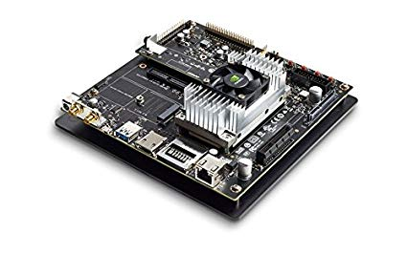
Embedded Again

Slide 4
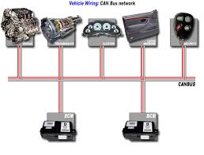
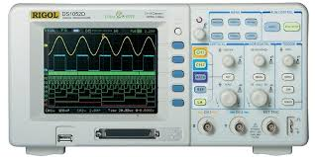
CAN Bus
24 volts !!!!

Slide 5
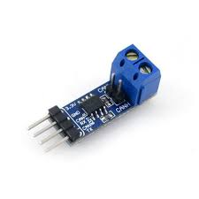
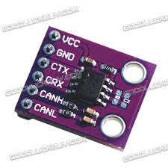
CAN Bus Again

Slide 6
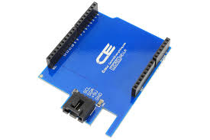
I2C
WIRE.H
WIRE.H
WIRE.H
WIRE.H
WIRE.H
WIRE.H
WIRE.H

Slide 7
Competition Learning Outcomes
The core learning outcome of the FSAE competition is achieving the skill set needed to work as an automotive engineer. For the engineers focused on data acquisition, that means understanding the fundamentals of data science and ensuring data is valid and reliable.
Data validation is the foundation for data oriented development.

Slide 8
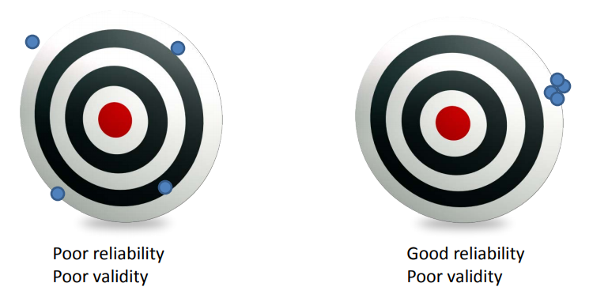
Aiming for Center

Slide 9
Models of Data Validation
Type 1: Cross Verifications
Cross verifications involve comparing programmatic results, for a given period, with other sources of information...
Identified discrepancies may suggest data quality issues
Gimbel, Sarah. “Approaches to Data Validation: Comparing Routine Data to a ‘Gold Standard.’” Science Programs, University of Washington, depts.washington.edu/cfar/sites/default/files/uploads/scientific-programs/health-systems/4.%20Data%20Audits%20-%20Gimbel.pdf.

Slide 10
Models of Data Validation
Type 2: Spot Checking
Validation in this case includes inspection of the image or other data object for errors (like missing lines) not specified in the label parameters, verification that the target shown/apparent geometry matches that specified in the labels, verification that the product is viewable using the specified software tools, and a general check for any problems that might not have been anticipated in the automated validation procedure.
“Data Validation.” Data Validation, Washington University in St.Louis, 2019, an.rsl.wustl.edu/msl/mslbrowser/help/Content/About%20the%20data/Data%20processing/Data%20validation.htm.

Slide 11
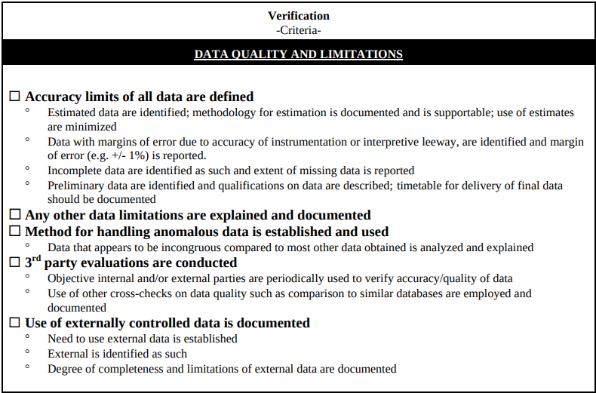
Bielak, LeRon E. “DATA VALIDATION AND VERIFICATION ASSESSMENT MATRIX .” University of North Texas Library, University of North Texas , 2003, cybercemetery.unt.edu/archive/oilspill/20121017173540/http://www.fws.gov/Planning/Documents/Validation/DOI_Performance_Data_V&V_Guide_Jan03.pdf.

Slide 12
More about Data Validation
Data analysts agree that their biggest challenges are data quality, validating assumptions, and understanding anomalies and errors throughout the process. These challenges are not about the correctness of their code but rather the validation of data analysts’ assumptions about their data and subsequent analytics.
Data Validation for Large-Scale Analytics Building Tools to Support Data Sampling and Visualization. Carnegie Mellon University, 2016, resources.sei.cmu.edu/asset_files/Poster/2016_020_001_484284.pdf.

Slide 13
Areas to be Explored
Valid data will allow us to conduct research in areas such as impact recognition or active aerodynamics
“Without valid data, data science practitioners cannot be sure that their resulting machine learning algorithms are making accurate predictions using relevant features and correct labels.”
Data Validation for Large-Scale Analytics Building Tools to Support Data Sampling and Visualization. Carnegie Mellon University, 2016, resources.sei.cmu.edu/asset_files/Poster/2016_020_001_484284.pdf.

Slide 14
THANKS!

